Slide 1

#RahoAmbitious
PG Diploma in DS

Slide 2



Course : Domain Elective
Lecture On : Gesture Recognition
Instructor : Manish Kumar

Slide 3
Today’s Agenda
1
What is Gesture Recognition Technology?
2
Applications of Gesture Recognition
3
Modelling - Steps
4
Generators
5
3D CNN
5
Conv + RNN

Slide 4


What is Gesture Recognition Technology?
Gesture recognition is the mathematical interpretation of a human motion by a computing device.
Gesture recognition is a type of perceptual computing user interface that allows computers to capture and interpret human gestures as commands. The general definition of gesture recognition is the ability of a computer to understand gestures and execute commands based on those gestures. Most consumers are familiar with the concept through Wii Fit, X-box and PlayStation games such as “Just Dance” and “Kinect Sports.”

Slide 5


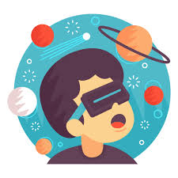

Applications of Gesture Recognition
“ The ability to perceive the shape and motion of hands can be a vital component in improving the user experience across a variety of technological domains and platforms. “
Medical Applications - Advanced robotics systems with gesture recognition can be placed in hospitals or homes to recognize and treat life threatening conditions like heart attacks or strokes
Alternative computer interfaces - Gesture recognition, along with voice recognition, facial recognition, lip movement recognition and eye tracking combined can be used to create something called a perceptual user interface (PUI) .
Entertainment applications - can also enable the overlay of digital content and information on top of the physical world in augmented reality
An easier life for the disabled - it can form the basis for sign language understanding and hand gesture control

Slide 6
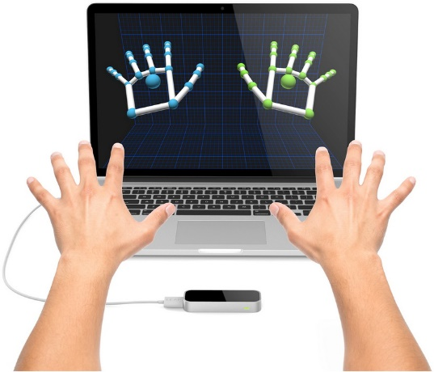
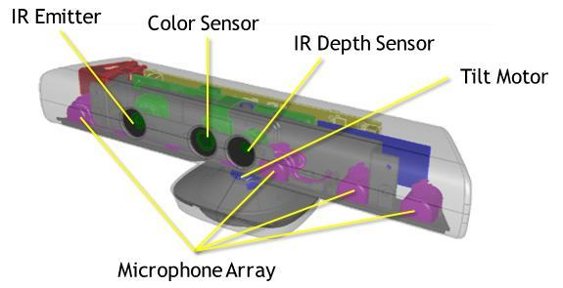
Current Solutions
Fascinating computer sensor that uses multiple cameras and IR light to detect motion in a 3D space. It can track both hands and complete body with good precision and speed

Slide 7
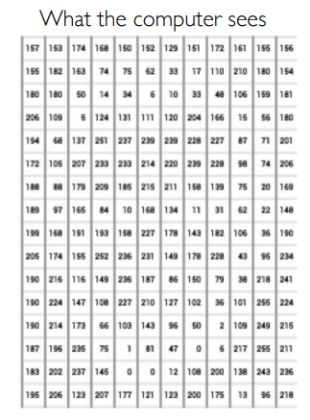
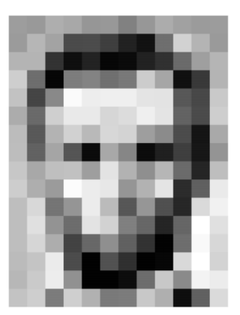
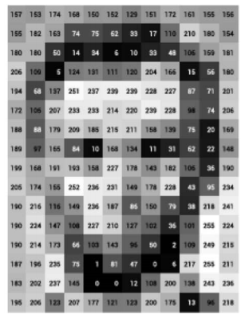
How computer sees an image ?

Slide 8
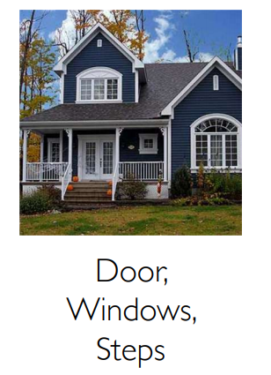
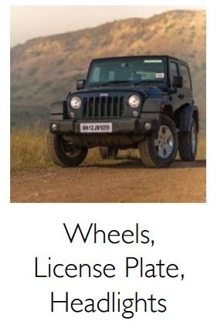
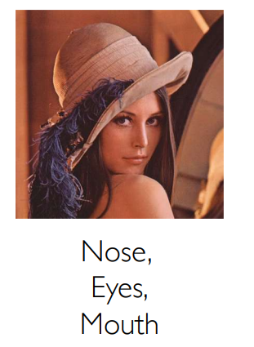
Image Features

Slide 9
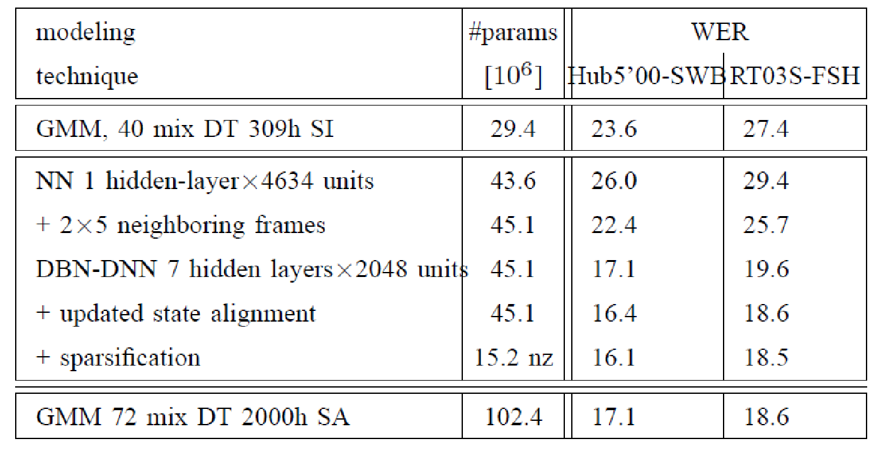
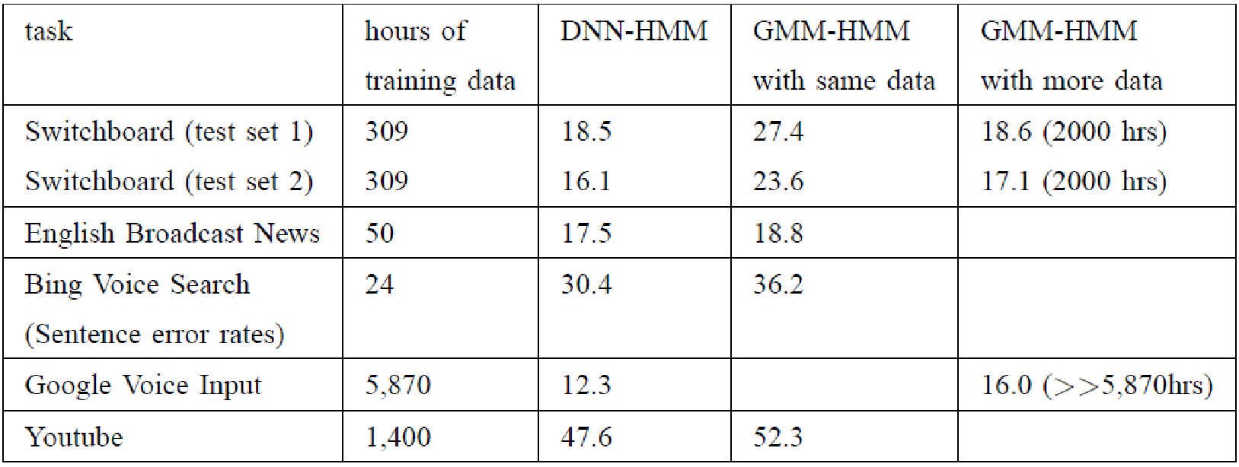
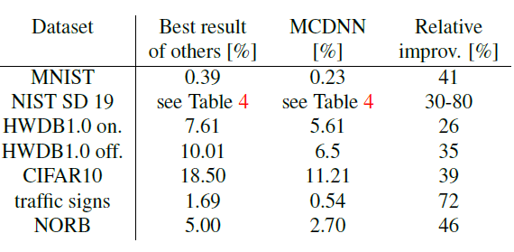
But why DL ??
DL is providing breakthrough results in speech recognition and image classification …
It’s better than us Humans if it’s trained well ☺ ,You can try beating it ;)
https://cs.stanford.edu/people/karpathy/ilsvrc/
http://yann.lecun.com/exdb/mnist/
http://people.idsia.ch/~juergen/cvpr2012.pdf

Slide 10

But why DL ??
A machine learning subfield of learning representations of data. Exceptional effective at learning patterns.
Deep learning algorithms attempt to learn (multiple levels of) representation by using a hierarchy of multiple layers
If you provide the system tons of information, it begins to understand it and respond in useful ways.

Slide 11
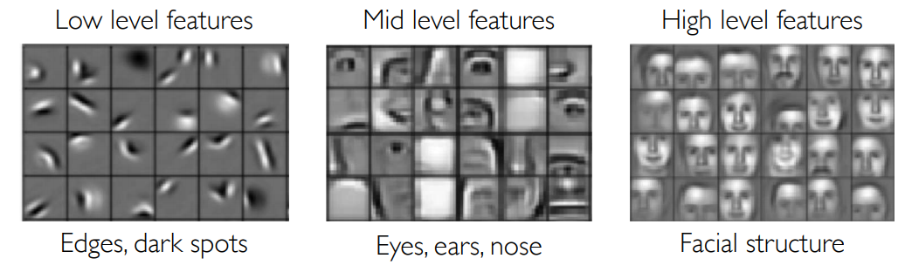
Learning Feature Representations
learning a hierarchy of features directly from the data instead of hand engineering?

Slide 12
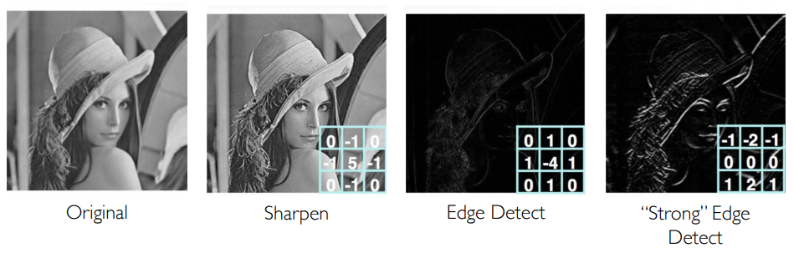
Feature maps

Slide 13
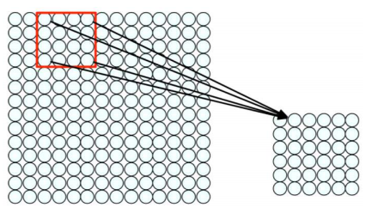
Convolution for Feature Extraction
Filter of size 4x4 : 16 different weights
Apply this same filter to 4x4 patches in input
Shift by 2 pixels for next patch
Apply a set of weights – a filter – to extract local features
Use multiple filters to extract different features
Spatially share parameters of each filter

Slide 14
But why DL ??
Manually designed features are often over-specified, incomplete and take a long time to design and validate
Learned Features are easy to adapt, fast to learn
Deep learning provides a very flexible, (almost?) universal, learnable framework for representing world, visual and linguistic information.
Can learn both unsupervised and supervised
Effective end-to-end joint system learning
Utilize large amounts of training data

Slide 15
All the work that we need to do can be split in 4 steps:
1
Generate and Prepare the Data
2
Create DL Model
3
Train & Test
4
Predict with DL Model
☺ So let’s start …

Slide 16
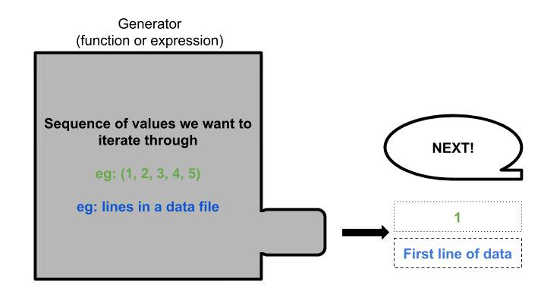
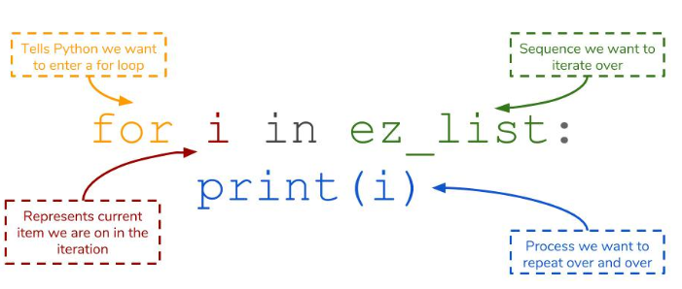
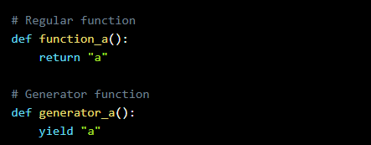
Understanding the generators
A generator function is just like a regular function but with a key difference:
the yield keyword replaces return.

Slide 17
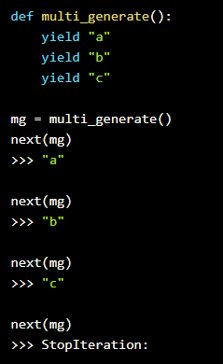
What is Gesture Recognition Technology?
generators produce a stream of values, so yielding a single value doesn’t really qualify as a stream.
To do this, we can actually put in multiple yield statements into a generator function. These yield statements form the sequence that the generator will output.
We’ll create a generator and bind it to a variable mg. Then, if we keep passing mg into next(), we’ll get to the next yield. If we keep going past, we’ll be given a StopIteration error to tell us that the generator has no more values to give.

Slide 18


Laziness and generators
We know now that generators produce a single value from a defined sequence, but only when we ask next() or within a for loop. We call this lazy evaluation.
Generators are lazy because they only give us a value when we ask for it. The flipside here is that only that single value takes up memory. The ultimate result is that generators are incredibly memory efficient, which makes it a perfect candidate for reading and using Big Data files.
Once we ask for the next value of a generator, the old value is discarded. Once we go through the entire generator, it is also discarded from memory as well.

Slide 19


“ That’s good but how is it going to help me in gesture recognition ? “
Have you ever had to load a dataset that was so memory consuming that you wished a magic trick could seamlessly take care of that? Large datasets are increasingly becoming part of our lives, as we are able to harness an ever-growing quantity of data.
But Deep learning models can work on batch data right? So why do we need to load the complete thing at once ?
That is the reason why we need to find other ways to do that task efficiently ☺

Slide 20
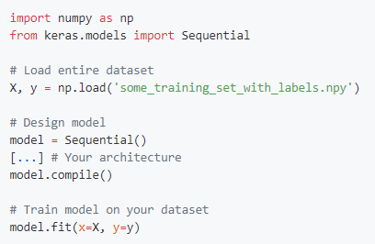
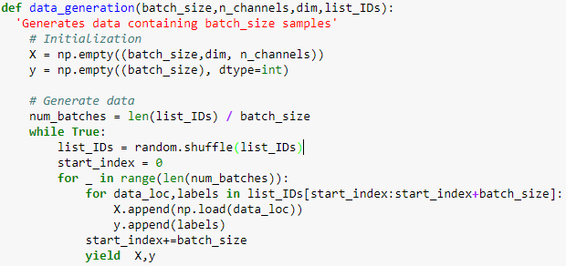
Data Generators
Previous situation
Data generators

Slide 21
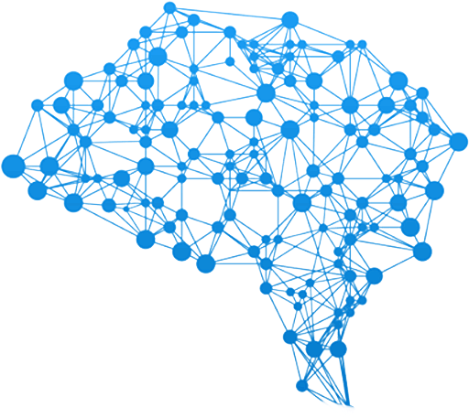
Neural Network Models
3D – CNN
CNN + RNN

Slide 22
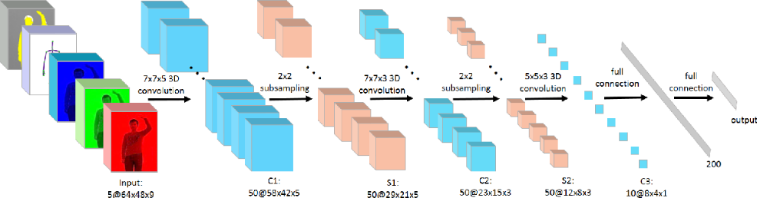
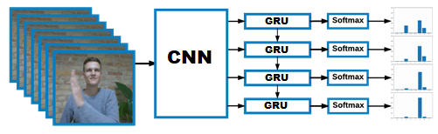
3D Convs and CNN-RNN Stack
For analyzing videos using neural networks, two types of architectures are used commonly
3D convolutional network it’s a natural extension to the 2D convolutions you are already familiar with. Just like in 2D conv, you move the filter in two directions (x and y), in 3D conv, you move the filter in three directions (x, y and z).
the standard CNN + RNN architecture in which you pass the images of a video through a CNN which extracts a feature vector for each image, and then pass the sequence of these feature vectors through an RNN

Slide 23
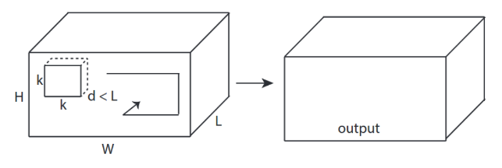

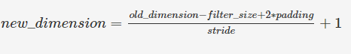
3D convolutional network
In the case of 3D convolutions, the kernel that is used to perform convolutions on the image or the feature map has an additional dimension namely depth.
The kernel performs convolutions by moving in all three dimensions that is x, y, and z-axis. The third dimension is considered to be time as 3D convolutions are used mostly for video classification.

Slide 24


Question
If we perform a 3D convolution using a (4x4x2) filter on a (128x128x10) matrix (with padding =1 and stride = 2). What will be the output size after convolution?
64x64x5
64x64x6
32x32x6
63x63x5

Slide 25

Solution
If we perform a 3D convolution using a (4x4x2) filter on a (128x128x10) matrix (with padding =1 and stride = 2). What will be the output size after convolution?
64x64x5
64x64x6
32x32x6
63x63x5
Practice in teams of 4 students
Industry expert mentoring to learn better
Get personalised feedback for improvements
23-02-2020

Slide 26
Question
calculate the number of trainable parameters if the input shape is (128x128x10)x3 and it is convolved with 32 3D filters of size (4x4x2) ?
1056
2112
3072
3104

Slide 27
Solution
Calculate the number of trainable parameters if the input shape is (128x128x10)x3 and it is convolved with 32 3D filters of size (4x4x2) ?
1056
2112
3072
3104
Practice in teams of 4 students
Industry expert mentoring to learn better
Get personalised feedback for improvements
32 x ( (4x4x2) x 3 +1 )
23-02-2020

Slide 28
Convolutions + RNN
The conv2D network will extract a feature vector for each image, and a sequence of these feature vectors is then fed to an RNN-based network. The output of the RNN is a regular softmax (for a classification problem such as this one).
Input with spatial structure, like images, cannot be modeled easily with the standard RNN.
Input
CNN
GRU
Dense
Dense
The CNN RNN(GRU) is an RNN architecture specifically designed for sequence prediction problems with spatial inputs, like images or videos.
it is natural to use a CNN as an image “encoder”, by first pre-training it for an image classification task and using the last hidden layer as an input to the RNN decoder which will capture the information hidden in the sequence of the images

Slide 29
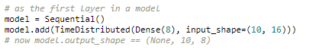
TimeDistributed
This wrapper applies a layer to every temporal slice of an input.
The input should be at least 3D, and the dimension of index one will be considered to be the temporal dimension.
Consider a batch of 32 samples, where each sample is a sequence of 10 vectors of 16 dimensions. The batch input shape of the layer is then (32, 10, 16), and the input_shape, not including the samples dimension, is (10, 16).
You can then use TimeDistributed to apply a Dense layer to each of the 10 timesteps, independently:
The output will then have shape (32, 10, 8).
https://keras.io/layers/wrappers/

Slide 30
Question
Consider a batch of 16 gesture samples, If the size of each image is 128x128 having 3 channels (RGB) and there are total 15 frames present for each gesture video, Input_shape = (15,128,128,3)
We want to apply a pre-trained conv2d model over each frame of the sequence using the time distributed function with 16, (2x2) filters, without padding and stride =2.
16x15x64x64x16
15x64x64x16
16x15x32x32x8
15x32x32x8

Slide 31
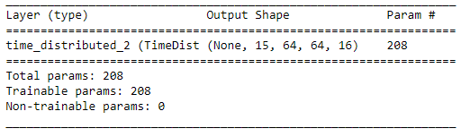
Solution
Consider a batch of 16 gesture samples, If the size of each image is 128x128 having 3 channels (RGB) and there are total 15 frames present for each gesture video, Input_shape = (15,128,128,3)
We want to apply a pre-trained conv2d model over each frame of the sequence using the time distributed function with 16, (2x2) filters, without padding and stride =2.
16x15x64x64x16
15x64x64x16
16x15x32x32x8
15x32x32x8
cnn = Sequential()
cnn.add(Conv2D(16,(2,2),strides=(2,2)))
model = Sequential()
model.add(TimeDistributed(cnn,input_shape=(15,128,128,3)))
model.summary()
Practice in teams of 4 students
Industry expert mentoring to learn better
Get personalised feedback for improvements
23-02-2020

Slide 32
Thank You !

